Slide 1
Project title
CAPSTONE PROJECT
Presented By:
Student Name- Unnati Yadav
College Name- SGT UNIVERSITY, Gurugram
Department- cognitive science

Slide 2
OUTLINE
Problem Statement
Proposed System/Solution
System Development Approach
Algorithm & Deployment
Result
Conclusion
Future Scope
References

Slide 3
Problem Statement
.
Planning a personalized trip according to our choices based on our resources ,budget is not easy .
Its quite time taking process and there are many problems that we face
Decision Paralysis- Spending hours scrolling through sites like TripAdvisor or Booking.com without actually making a decision.
Lack of Cultural & Operational Context -Planning based on place names rather than operational reality. People forget to check if particular place is open at what timings.
A traveler might know where they are going but not why it matters or when to go.

Slide 4
Proposed Solution
To ease this task of travel planning so that just people can create itineraries and plan in minute
So that one explore more and plan less
So, for this I have built ROAM ai tool
It will create itineraries with in minutes
Also, a currency converter to know the amount in any currency
Includes opening and closing time of the places

Slide 5
System Approach
To build R 🌍 AM, a multi-phase development approach was adopted, moving from requirement analysis to AI orchestration and final deployment .I used blink ai tool with the help of it I built as it .
It offers vibe coding.
Automated Full-Stack Infrastructure
STEP-1 Problem Identification & Requirement Gathering
STEP-2 System Architecture & Logic Design
STEP3 Integration & Data Enrichment
STEP4-Testing, Refinement & Deployment

Slide 6
Algorithm & Deployment
ALGORITHIM
Frontend: React / Next.js with Tailwind CSS (for the 3D landing page and responsive UI).
Backend: Serverless Edge Functions that handle API calls between the user and the LLM.
Database: PostgreSQL to store user profiles and Saved Trips .
AI Engine: A "Multi-Agent Orchestration" (GPT-4o/Claude 3.5) that parses natural language and outputs structured JSON data.
This is the "Travel Agent" logic. It filters thousands of options to pick exactly three hotels (Budget, Mid-range, and Luxury) and calculates every expense in INR, ensuring the plan actually fits your wallet.
Deployment
In modern tools like Blink AI, deployment is Continuous.
Instant Launch (CI/CD):The system automatically updates the live site.
The Invisible Backend: I used Serverless Infrastructure. This means the app doesn't need a single big computer to run; it scales automatically. Whether 1 person or 100 people use it, the experience stays smooth and secure.

Slide 7
Result
Fully Functional AI Core: Successfully integrated a multi-agent AI system that transforms a single text prompt into a comprehensive , makes multiday travel plan.
Dynamic Budgeting Accuracy: Implemented a real-time INR (₹) Currency Logic that accurately calculates daily burn rates, hotel stays, and total trip costs, eliminating financial guesswork for Indian travelers .
Diverse Suggestion Engine: The system consistently generates three distinct hotel tiers (Budget, Mid-range, Luxury) per destination.
Enrichment: generate itineraries which include Famous things of that place and precise Opening/Closing Times ensuring high operational reliability for the traveler.
Seamless Portability: Developed a one-click PDF Export & Dashboard Save feature, allowing users to transition from online planning to offline travel instantly .

Slide 8
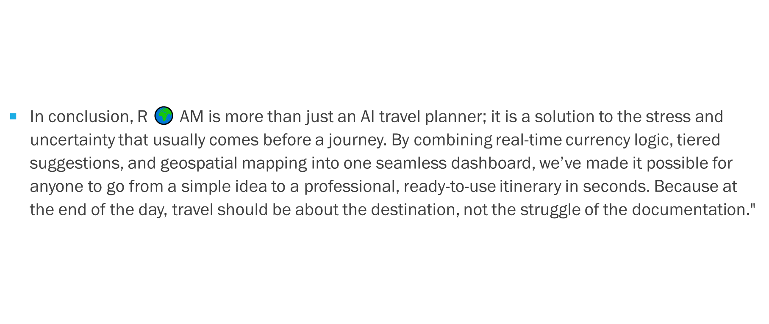
Conclusion

Slide 9
Future scope
One-Click Booking: Moving from just "planning" to "doing" by letting you book your entire trip—flights, hotels, and tours—directly through the app.
Weather-Smart Plans: An AI that watches the forecast and automatically swaps your beach day for a museum visit if it starts to rain.
Price-Drop Alerts: Smart tracking that notifies you when your dream hotel becomes cheaper in INR, ensuring you always get the best deal.
Group Harmony: A "Shared Brain" feature where friends can vote on hotels and split bills easily, ending the stress of group chat planning.
Personal Travel "Vibe": An AI that learns your style over time—knowing exactly when you want a quiet café and when you’re ready for an adventure.
.

Slide 10
References
Hugging Face – The AI community building the future.
Blink AI

Slide 11
Github link
GitHub Link :https://github.com/unnxtiss/ai-travel-planner/tree/main

Slide 12
THANK YOU

